Slide 1
DepEd Order No. 8 s. 2007 Revised Implementing Guidelines on the Operation and Management of School Canteens in Public Elementary and Secondary Schools

Slide 2
1.0 Purpose
1.1 The school canteen shall help eliminate malnutrition among pupil/students.
1.5 Service should be the main consideration for operating a school canteen. Profit shall be secondary since the clientele are puplis/students who are dependent only to their meager allowance from their parents.
1.6 Reporting and accounting of the proceeds from the operations of a school canteen shall be made by the parties concerned to emphasize transparency and accountability.

Slide 3
3.0 Definition of Terms
3.2 School-Managed Canteen – refers to a school canteen that is operated and managed by the school under the general supervision of the school head/principal.
3.3 Teachers’ Cooperative Managed Canteen – refers to a school canteen that operated and managed by a duly registered teachers’ cooperative.
3.6 Administrative Expense – refers to general expenses of business operation such as salaries, supplies, water, bills and insurance, etc.

Slide 4
3.0 Definition of Terms
3.7 Cost of goods sold – is equal to the inventory at the beginning of the year, adding the cost of goods manufactured or purchased during the year, minus the inventory at the end of the year.
3.8 Selling expense – refers to the expenses of promoting, selling and distributing products which may include such items as advertising, commissions, delivery expenses, travel expenses and entertainment.
3.9 Gross Margin – refers to the difference between gross sales and cost of goods sold including the cost of freight and production directly related to the preparation of the food items.

Slide 5
4.0 Policy Statements
4.1 School canteens shall be of two types: (1) School-Managed Canteen; (2) Teachers’ Cooeprative-Managed Canteen. Both shall adhere to professional management and sound business practices as well as to safety and security measures.

Slide 6
4.0 Policy Statements
4.7 A reasonable mark-up price for all merchandise in the canteen shall be allowed, provided that the selling retail price does not exceed the prevailing prices in the locality.
4.8 Sub-leasing the whole or part of the school canteen premises or sub-contracting the operation of the school canteen to concessionaires is prohibited.

Slide 7
5.0 Procedural Guidelines
5.3 Reportorial Requirements
5.3.1 All entities operating and managing a school canteen, including the laboratory canteen, shall regularly prepare the following reportorial requirements to be submitted to the DepEd and/or CDA, whichever is applicable:

Slide 8
5. Procedural guidelines
Category of Reports | Type of Reports | Date of Submission
Category A-1
To be submitted to the Department of Education, specifically to the school head in case of teachers’ coop managed, and division office in case of school-managed canteens | Statement of Financial Condition Statement of Operations Statement of Cash Flows Notes to Interim Financial Statement and other disclosures Summary of Cost of Sales | Quarterly submission with deadline dates of May 15, August 15, November 15, and February 15

Slide 9
5. Procedural guidelines
Category of Reports | Type of Reports | Date of Submission
Category A-2
To be prepared and maintained at all times and posted on the school’s bulletin board and/or in any conspicuous place within the school premises | Bank Reconciliation Schedule of Cost of Sales Schedule of Operating Expenses Schedule of Utilization of School Share Program Received from the Cooperative Schedule of Utilization of Gross Income Generated from the Canteen Laboratory | Monthly with deadline date of every 10th of the following month.

Slide 10
5. Procedural guidelines
Category of Reports | Type of Reports | Date of Submission
Category A-2
To be prepared and maintained at all times and posted on the school’s bulletin board and/or in any conspicuous place within the school premises | (6) Statement of Receipts and Disbursements (7) Statement of Reports on Cooperatives’ School Program Support (8) Schedule of Capitalization on the Operation of School Canteen | Monthly with deadline date of every 10th of the following month.

Slide 11
5. Procedural guidelines
Category of Reports | Type of Reports | Date of Submission
Category B
To be submitted on an annual basis to or as required by the CDA (for teachers’ cooperative only) copy furnished the school head/principal | Audited Financial Statements including notes and disclosures Financial Performance Standards Annual Report to CD List of Directors and Officers Report on Crimes and Losses | May 15 May 15 60 days after end of fiscal year 30 days after the GA meeting; and 15 days following assumption of office To be submitted as crime/incident occurs on the 5th bus. Day after knowledge of crime or incidents

Slide 12
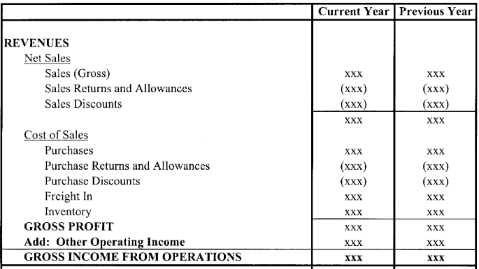

Slide 13
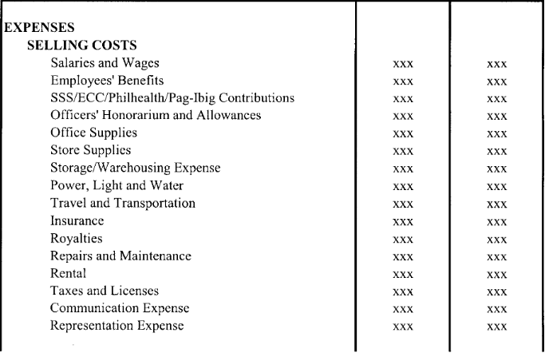

Slide 14
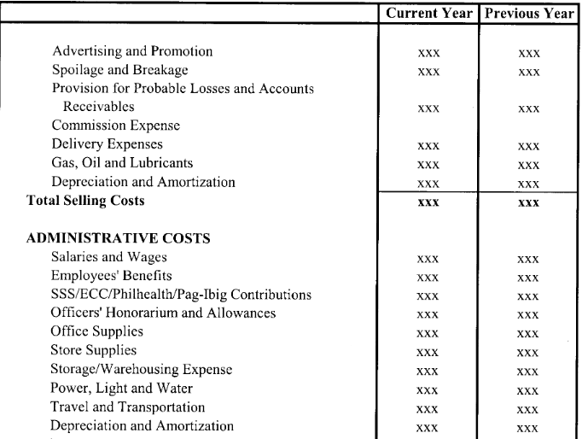

Slide 15
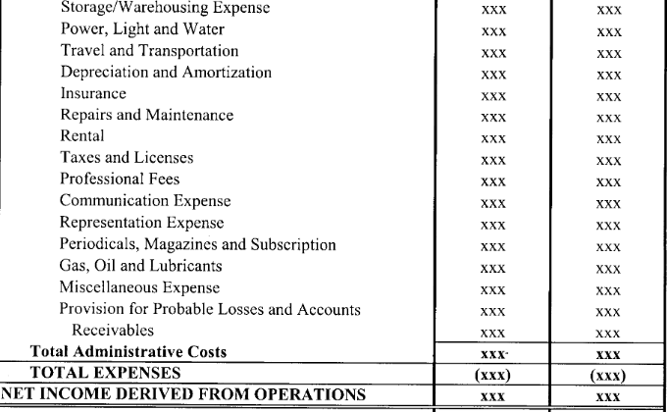

Slide 16
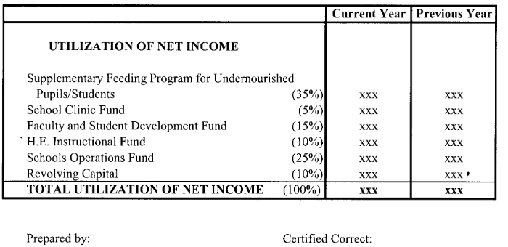

Slide 17
Different Schedules
Cash Book
Sales Schedule
Schedule of Cost of Sales
Schedule of Administrative Expenses
Schedule of Selling Expenses
Schedule of Accounts Receivable
Schedule of Utilization of Income from Canteen
Schedule of Utilization of School Share Program Received from the Cooperative

Slide 18
5. Procedural guidelines
5.3 Reportorial Requirements
5.3.2 The school-managed canteen shall prepare its financial statements using the pro-forma copies of the monthly statement of operation and financial statements which are hereto attached as annexes “B” and “C”, respectively. Teachers’ cooperative managing school canteen shall follow the Standard Chart of Accounts for Consumers’ Cooperative and Those with Canteen and/or Catering Services prescribed by the CDA which is here to attached as Annex “D”

Slide 19
5. Procedural guidelines
5.3 Reportorial Requirements
5.3.3 The school head/principal shall also post on the school’s bulletin board a statement of receipts and disbursements, indicating the share it received from the teachers’ cooperative managed canteen.

Slide 20
5. Procedural guidelines
5.4 Accounting of Funds
5.4.1 A book of accounts and statement of sales and disbursements shall be maintained for recording daily transactions related to the operations of the canteen. Receipts and other similar documents shall be kept to support sales, purchases and disbursements made. The books of accounts should be kept up to date and made by the school level auditing committee or the COA representative based in the division office.

Slide 21
5. Procedural guidelines
5.4 Accounting of Funds
5.4.2 For purpose of transparency and accountability, the school head/principal shall organize a school level auditing committee to be headed by a Mathematics department head/teacher, and Home Economics department head/teacher and the president of the faculty club as members. The committee shall look into the books of accounts at least once a month. The audited statement shall be posted on the school’s bulletin board.

Slide 22
5. Procedural guidelines
5.4 Accounting of Funds
5.4.3 Canteen funds shall be audited by the school level auditing committee on a quarterly basis and by the Division COA Resident Auditor or his/her authorized representative twice a year. Audit finding shall be submitted to the Schools Division financial statements shall be posted on bulletin boards for the information of everybody.

Slide 23
5. Procedural guidelines
5.5 Incentives received in cash or in kind from private suppliers of food items and beverages shall form part of the gross income of the school canteen and shall be part of the financial statement.

Slide 24
6.0 Specific guidelines for School-Managed Canteens
6.4 The Canteen Teacher shall be responsible in the preparation and submission of reports and the books of accounts and statement of sales and disbursements required enumerated in Procedural Guidelines 5.3.1 and 5.4.1, respectively.
6.5 The net income derived from the operation of the canteen shall be utilized for , but not limited to the following:

Slide 25
6.0 Specific guidelines for School-Managed Canteens
Supplemental feeding program for undernourished pupil/students | 35%
School Clinic Fund | 5%
Faculty and student development fund | 15%
H.E. instructional fund | 10%
School operations fund | 25%
Revolving Fund | 10%
Total | 100%

Slide 26
6.0 Specific guidelines for School-Managed Canteens
6.6 Earning and cash received from canteen operations shall be deposited daily in the nearest government depository bank. In the absence of such government depository bank, deposits shall be made at any nearest reputable commercial bank. In no case shall the deposits be made in the personal account of any school official. A school-managed canteen shall have a bank account “in trust for” the name of the school, whereby the school head/principal and the Canteen Teacher shall be the joint signatories.

Slide 27
6.0 Specific guidelines for School-Managed Canteens
6.8 Disbursement of canteen funds shall be in accordance with the approved budget and existing accounting and auditing rules and regulations.
6.9 Teachers and canteen personnel shall be required to secure clearance from money and property accountabilities in relation to their involvement in the operation and management f the school canteen before they are allowed to retire and/or resign from government service, or transfer to other posts for purposes of re-assignment or promotion to a higher position.

Slide 28
7.0 Specific Guidelines for Teachers’ Cooperative-Managed Canteens
7.10 Sharing of Proceeds
The sharing of the gross margin derived from the teachers’ cooperative-managed canteen shall be as follows:
a. Eighty percent (80%) for the teachers’ cooperative and twenty percent (20%) for the school. However, the school head/principal and teachers cooperative may agree on other percentage of sharing depending on the peculiar situation of the school: Provided that the share of the school shall not be less than twenty present (20%). Remittance of the school share shall be due every fifth day of the month.

Slide 29
7.0 Specific Guidelines for Teachers’ Cooperative-Managed Canteens
b. The school head/principal or his/her duly authorized representative shall receive the school share from the teachers’ cooperative and issue the corresponding acknowledgement receipt duly signed by the school head/principal or his/her duly authorized representative. Any authorized disbursement made chargeable against such share shall be recorded, accounted for and supported by receipts.

Slide 30
7.0 Specific Guidelines for Teachers’ Cooperative-Managed Canteens
c. The share of the school shall be utilized as follows:
Supplemental feeding program for undernourished pupil/students | 35%
School Clinic Fund | 5%
Faculty and student development fund | 15%
H.E. instructional fund | 10%
School operations fund | 35%
Total | 100%

Slide 31
Thank you!

